Slide 1
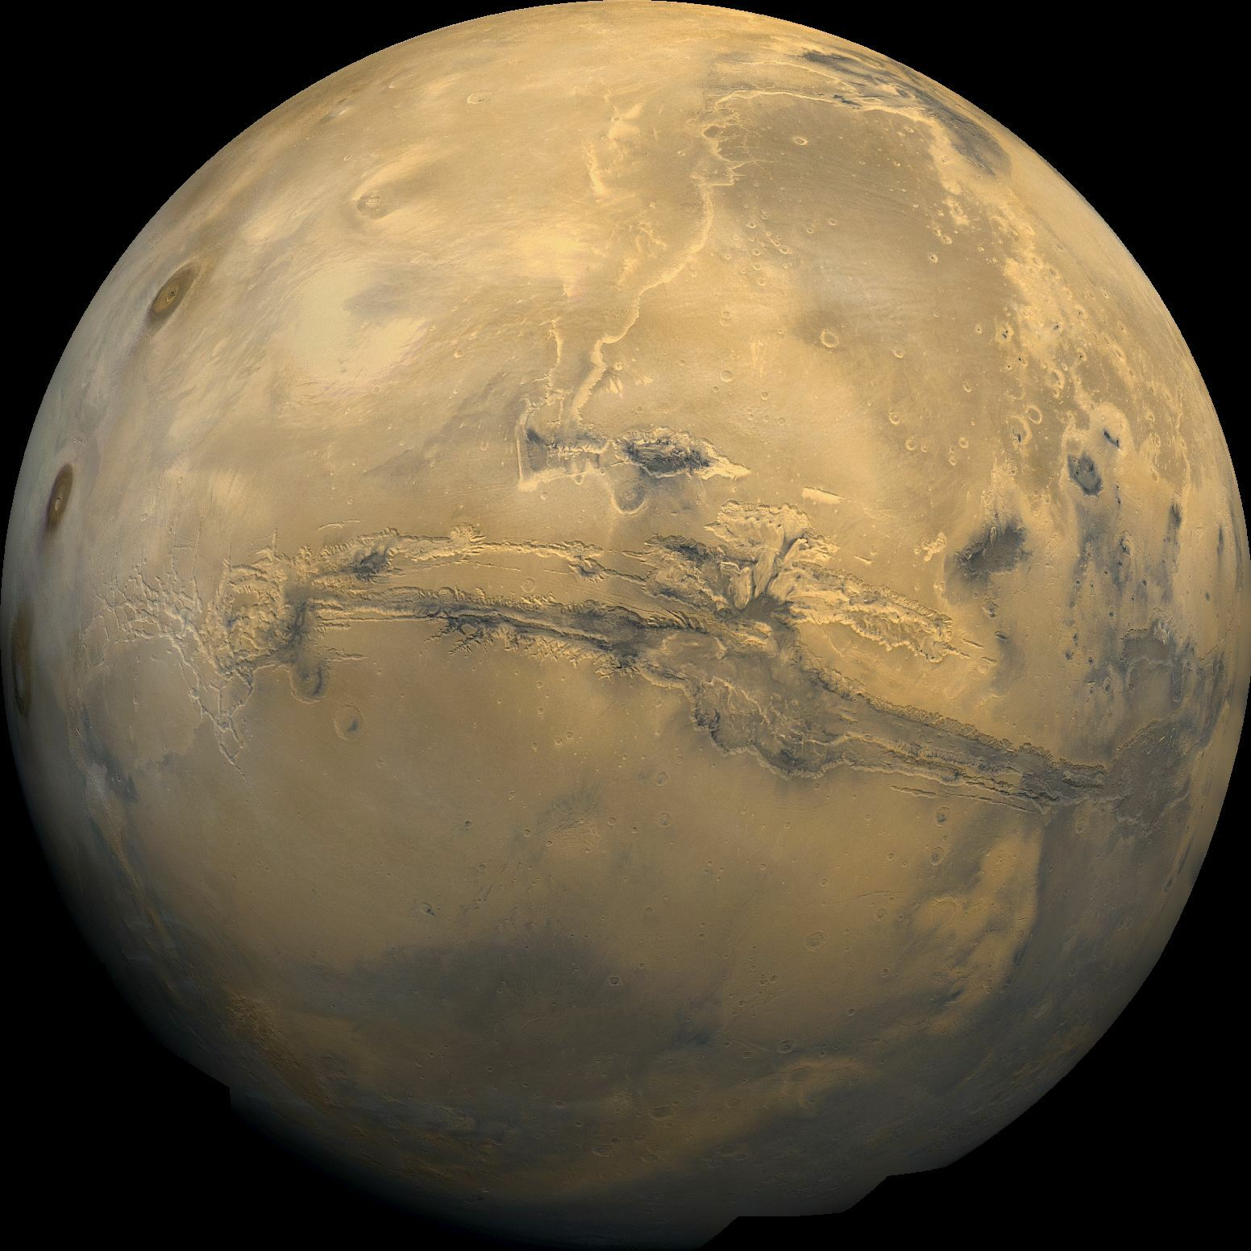
Brine Stability at Reccuring Slope Lineae in Valles Marineris, Mars
Bradley Patterson and Dr. Phil Christensen
Arizona State University School of Earth and Space Exploration

Slide 2
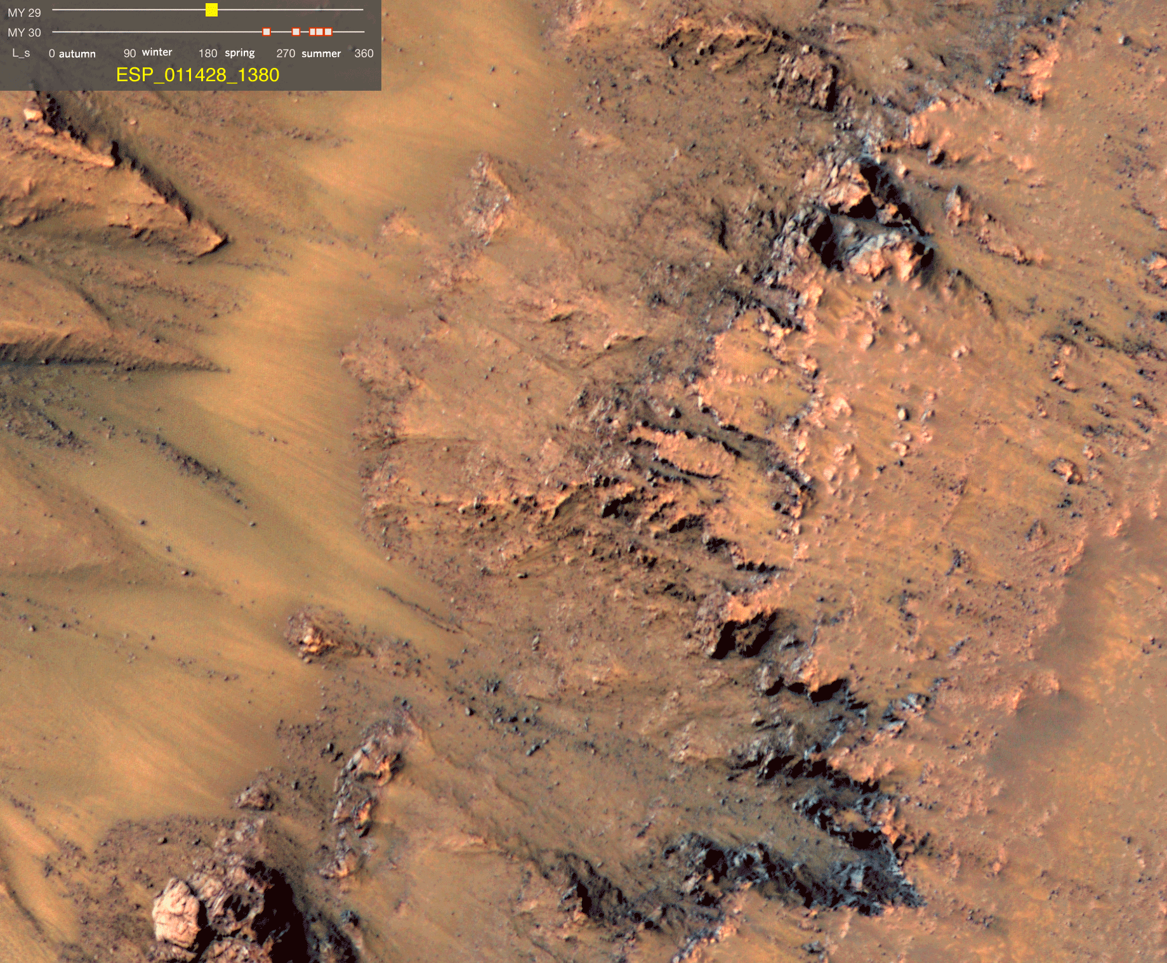
Appearance of RSL
Narrow (.5-5m), dark (40% darker) streaks that appear on steep (~30 degree) Martian slopes
Found on steep (~30 degree) slopes
They generally appear in warm seasons, lengthen and then fade in cooler seasons
Re-appear over multiple years
By NASA/JPL-Caltech/Univ. of Arizona

Slide 3
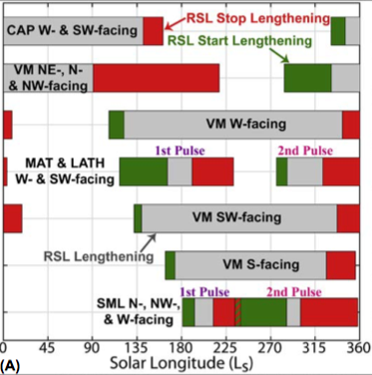
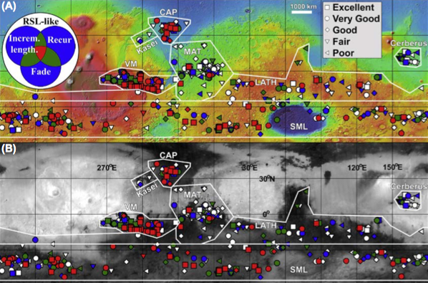
Locations and seasonality
A) Map of all candidate and confirmed RSL over Mars Orbital Laser Altimeter colorized elevation map. B) Map of all candidate ad confirmed RSL over a Thermal Emission Spectrometer derived albedo map. (D.E. Stillman, 2018)
Seasonality of RSL across Mars (D.E. Stillman, 2018)

Slide 4
Major formation theories
Adapted from Stillman ,2018, Dynamic Mars Stillman, 2018
Wet-Triggered Flows Massé et al., 2016 Raack et al., 2017 | Wet-Dominated Flows Stillman et al, 2016 Grimm et al., 2014 | Dry Granular Flows Dundas et al., 2017 Schmidt et al., 2017
Supporting Details Explains seasonality Requires only small (plausible) amount of liquid water Water could be supplied to isolated peaks by deliquescence Explains RSL on slopes below angle of repose Problems Unclear how fresh water would reach boiling temperature during the early spring Does not explain why RSL start from bedrock Does not explain short fading timescale of RSL | Supporting Details Explains seasonality Sub-surface aquifer source would explain bedrock origin Explains lengthening rates Explains RSL on slopes below angle of repose Problems Requires large quantity of liquid water Sub-surface aquifers thermally and hydrologically challenging | Supporting Details Requires little to no water Explains bedrock origin of RSL (Schmidt et al., 2017) Explains darkening process Problems Does not explain short fading timescale of RSL Does not explain removal/resetting of transported material

Slide 5
Methods
In JMARS, select sites with and without RSL in Valles Marineris for comparison
At each site collect:
  Elevation (MOLA)
  Slope gradient (MOLA)
  Slope azimuth (MOLA)
  Surface albedo (TES)
  Surface temperature (THEMIS)
  Thermal inertia (THEMIS & KRC Simulated One-Point Mode)
Run KRC for each site and fit model to THEMIS BTR temperatures
Run families of curves varying the slope and slope azimuth
  Compare these results to the seasonality of RSL and stability of brines on the surface

Slide 6
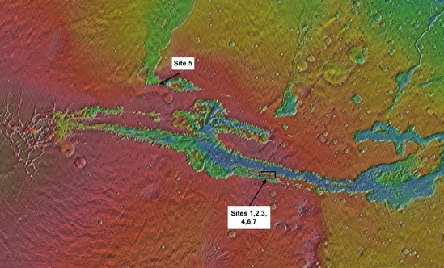
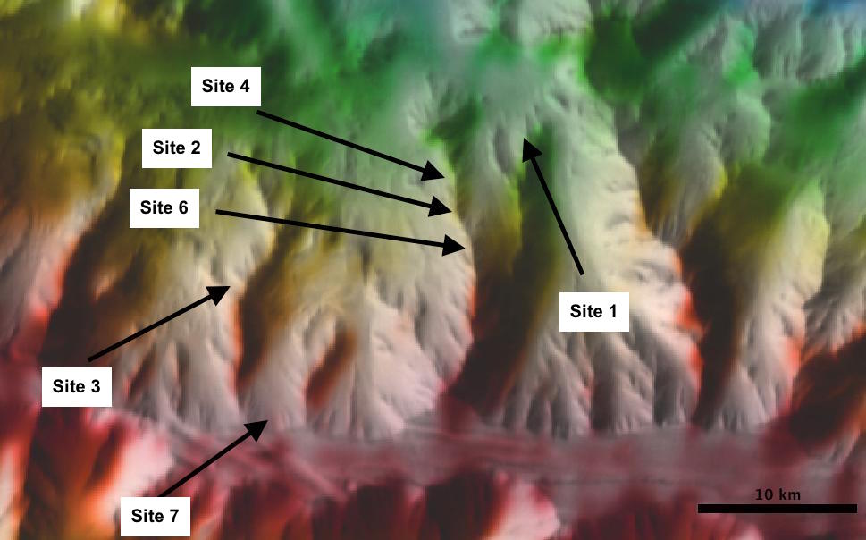
Site locations

Slide 7
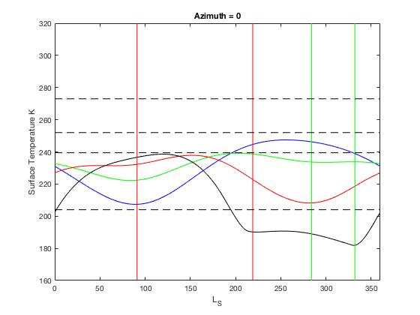
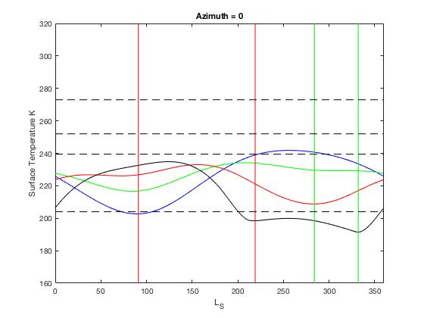


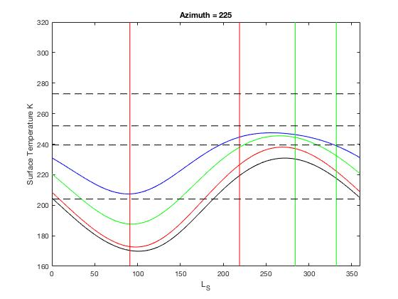
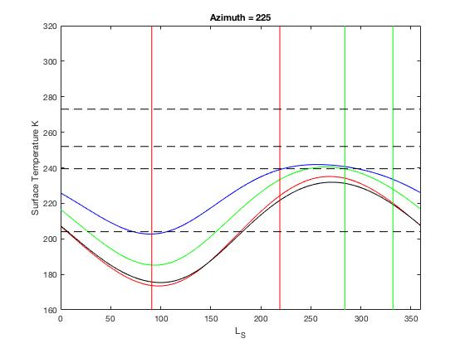

Results:
Site 2 5 cm depth | Site 4 5 cm depth
0 deg
30 deg
60 deg
90 deg
Times RSL begin lengthening
Times RSL fade
Freezing temperature of:
Water at 273 K
NaCl at 253 K
MgCl₂ at 239 K
Mg(SO₄)₂ at 204 K

Slide 8
Implications
Wet-Triggered Flows | Wet-Dominated Flows | Dry Granular Flows
Deliquescence would be connected to the rocky outcroppings Hydrated salts could be detected | Aquifer must be liquid at depth Flows would likely be extremely briny 44 wt% Mg(SO₄)₂ Salt cemented crusts should be observed Salt cemented crusts have not been observed | Related to heating of rocky outcroppings Possibly Knudsen pump or thermal stresses loosening material

Slide 9
Conclusions
Key points
  RSL activity corresponds temperature increase on steep (> 60 degree) slopes or the face of rocky outcroppings
  Temperatures curves show that brines would need to provide substantial freezing point depression

Slide 10
Acknowledgments
I would like to thank Dr. Christensen, Dr. Piqueux, and Dr. Ruff for their guidance on this project. I would also like to thank all those that contributed to discussions along the way.

